Slide 1
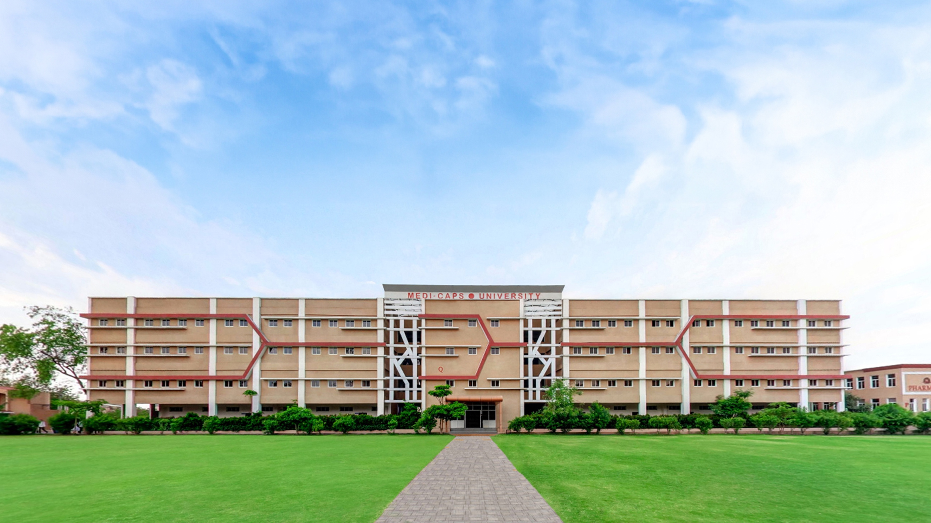

Hand Gestures Recognition
Session 2024-25

Slide 2
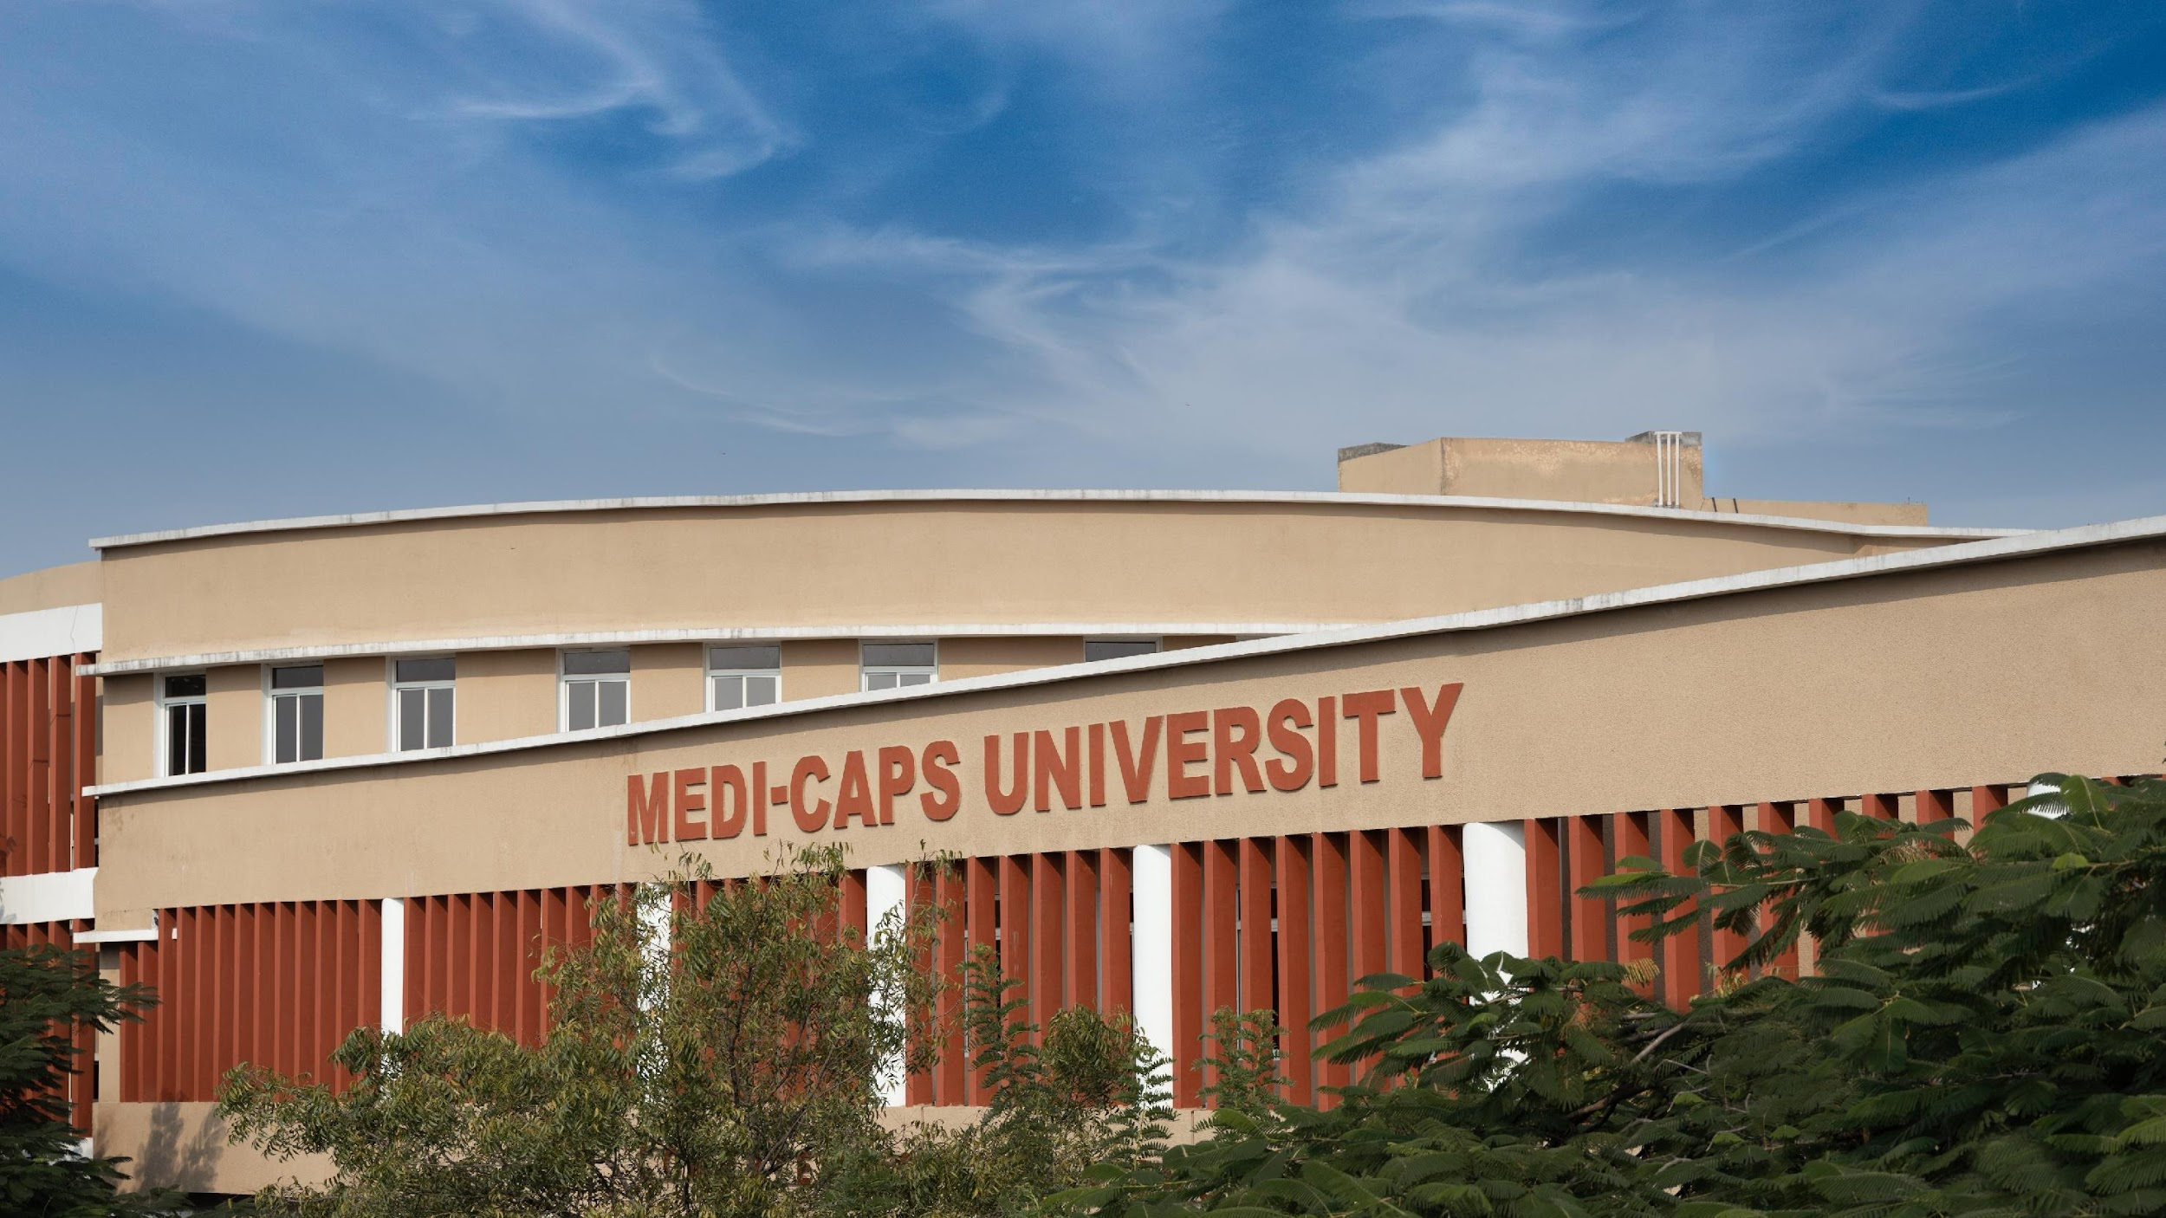
Hand Gesture Recognition

Slide 3
Contents -
Abstract
Introduction
Problem statement
Solution
Software requirements
UMLs Methodology
Tools and technologies used
Results
Conclusion and future work
Applications of project.

Slide 4
Abstract
Hand Gesture Recognition (HGR) using OpenCV and Mediapipe is an innovative approach to controlling mouse and keyboard functions through intuitive hand gestures. This project bridges the gap between humans and computers by enabling touchless interaction, leveraging computer vision techniques for real-time gesture detection and processing. OpenCV is utilized for image preprocessing and frame analysis, while Media pipe's powerful hand-tracking framework identifies and interprets hand landmarks to recognize specific gestures. These gestures are mapped to mouse and keyboard commands, allowing users to perform actions such as moving the cursor, clicking, and typing without physical input devices.

Slide 5
Introduction
Hand Gesture Recognition (HGR) enhances human-computer interaction by enabling touchless control using intuitive gestures. Traditional input methods like keyboards and mice can be restrictive, especially for individuals with disabilities or in touchless-required environments. HGR provides a seamless and natural way to interact with computers using hand gestures. This project uses OpenCV for video processing and Mediapipe for hand landmark detection to develop a real-time system. Gestures are mapped to mouse and keyboard actions, enabling cursor movement, clicks, and typing. The system provides an accessible and user-friendly solution with applications in gaming, VR, and smart environments.

Slide 6
Problem Statement
Traditional input devices like mice and keyboards can be restrictive, especially for individuals with motor disabilities or in environments requiring touchless interaction. There is a need for an alternative, intuitive input method to enhance accessibility and usability. This project addresses the challenge by developing a real-time hand gesture recognition system using OpenCV and Mediapipe to control mouse and keyboard functions. The system interprets hand gestures and maps them to specific commands, providing a user-friendly and practical solution for human-computer interaction. It aims to offer robust performance across diverse conditions while enabling touchless control for various applications.

Slide 7
Real-time Recognition: Uses OpenCV and Mediapipe for detecting and interpreting hand gestures.
Hand Tracking: Mediapipe identifies hand landmarks to recognize gestures.
Action Mapping: Gestures are linked to mouse (e.g., cursor movement, clicks) and keyboard functions.
Robust Detection: Works efficiently under varying conditions using video frame processing.
Accessibility: Provides a touchless alternative for individuals with disabilities.
Scalable Design: Easily integrates with applications like gaming, smart homes, and VR.
Solutions

Slide 8
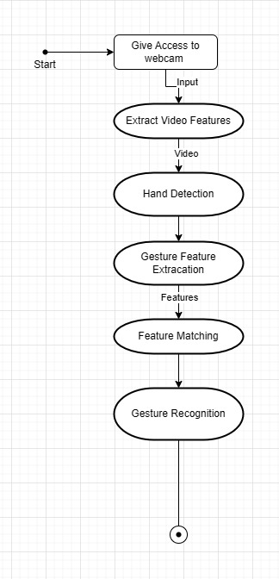
UML Diagrams
1.Flow chart

Slide 9
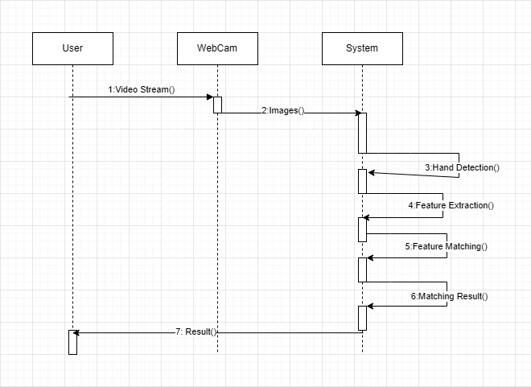
UML Diagrams
2. Sequence Diagram

Slide 10
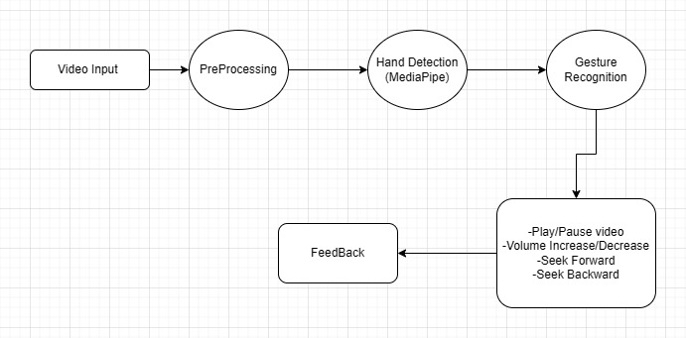
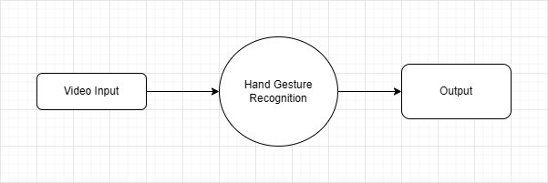
UML Diagrams
3.Data Flow Diagram (DFD)
Level 0 DFD: Level 1 DFD:

Slide 11
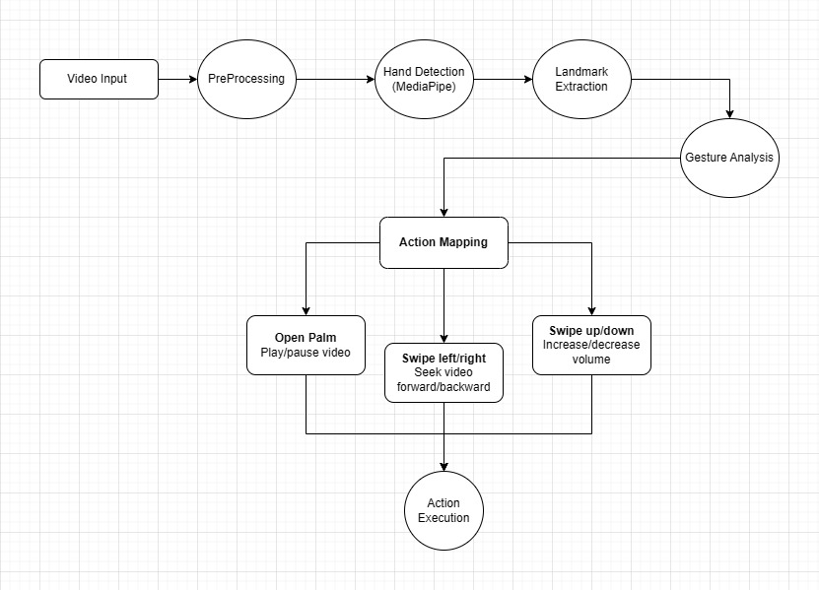
UML Diagrams
3.Data Flow Diagram (DFD)
Level 2 DFD:

Slide 12
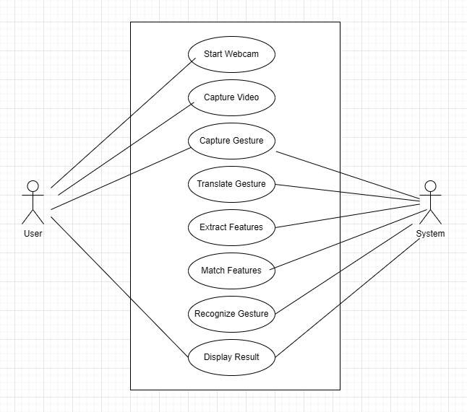
UML Diagrams
4.Use Case Diagram

Slide 13
Tools and technologies used
Programming Language:
Python: For implementing the system's core functionalities.
Libraries and Frameworks:
OpenCV: For real-time video frame capture and processing.
Mediapipe: For hand landmark detection and gesture recognition.
PyAutoGUI: For simulating mouse and keyboard actions based on recognized gestures.
Integrated Development Environment (IDE):
PyCharm or VS Code: For writing, debugging, and testing code.
Hardware:
Webcam: For capturing real-time video input.

Slide 14
Result
High Accuracy: Recognized hand landmarks and gestures reliably under varying conditions.
Real-Time Performance: Delivered smooth and responsive gesture-to-action mapping.
Gesture Mapping: Successfully controlled mouse (e.g., cursor movement, clicks) and some keyboard functions.
Robustness: Worked well across different hand sizes, orientations, and lighting conditions.
Accessibility: Provided a touchless alternative, especially beneficial for individuals with disabilities.
Ease of Use: Simple setup with minimal calibration required for users.

Slide 15
Conclusion
Developed a robust, real-time Hand Gesture Recognition system.
Achieved accurate and responsive mouse and keyboard control.
Demonstrated usability in diverse conditions and applications.
Provided a scalable, touchless solution for enhanced accessibility.
Future work
Add more gestures for expanded functionality.
Optimize for mobile and wearable platforms.
Improve accuracy in challenging environments.
Integrate with AR/VR and smart devices.
Enable user-defined, customizable gestures.

Slide 16
Applications of project
Hands-Free Computer Control: Use hand gestures instead of a mouse or keyboard.
Media Control: Control media playback (play, pause, volume) with gestures.
Mouse Pointer Control: Move the cursor on the screen using hand gestures.
Basic Navigation: Navigate through applications or web pages using swipe gestures (e.g., left, right, up, down).
Volume Control: Control the volume of the system by gestures (e.g., swipe up or down for increasing or decreasing volume).
Slide Show Navigation: Control presentations by swiping left or right to move through slides.

Slide 17
End Users
Students and Developers: For learning and experimenting with gesture-based systems.
Educators and Trainers: For teaching computer vision and Flask concepts.
Beginners in AI/ML: For understanding gesture recognition and Python-Flask integration
Home Users: People who want to control their computer or media devices hands-free.
Office Workers: Individuals who use presentation software and need an easy way to navigate slides during meetings.
Tech Enthusiasts: For testing innovative interaction methods.

Slide 18
Thank You!

